Slide 1
Travel Agency Dashboard
Power BI Project Presentation
AYUSHMAN AYUSH ayushmanayush899@gmail.com

Slide 2
Project Overview
This dashboard helps a travel agency understand:
- Customer travel behavior
- Popular destinations
- Revenue trends
- Age group preferences
The goal is to support business decisions and improve marketing strategies.

Slide 3
Dataset Information
The dataset contains 50 customer records with:
- Customer ID
- Age and Age Group
- Destination
- Booking Date
- Travel Type
- Revenue

Slide 4
Key Performance Indicators
- Total Customers
- Total Bookings
- Total Revenue
- Average Trip Cost

Slide 5
Dashboard Visuals
- Age Group vs Destination
- Revenue by Destination
- Monthly Booking Trend
- Travel Type Distribution
- Popular Destinations

Slide 6
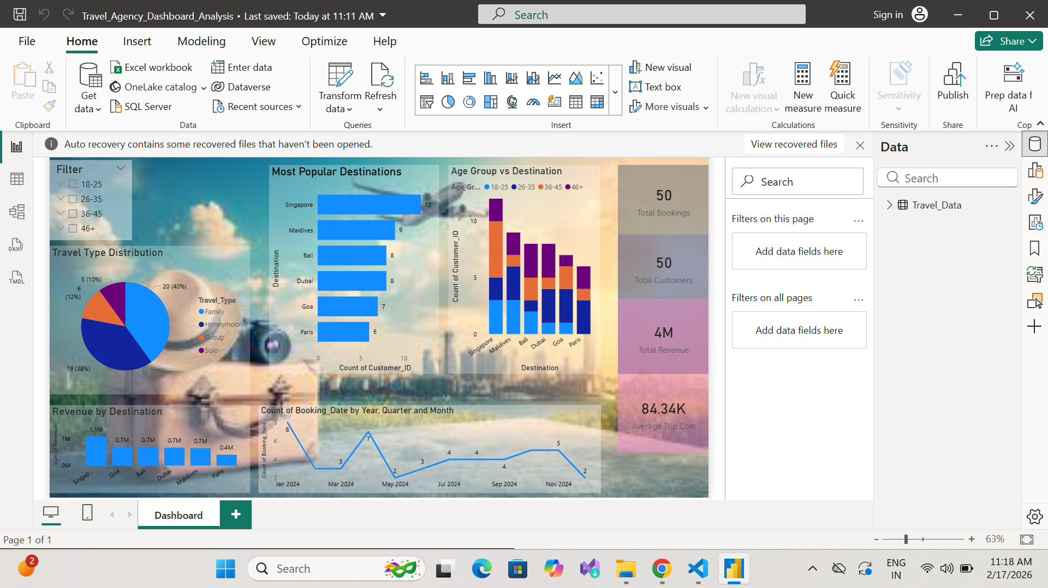
Dashboard Screenshot

Slide 7
Key Insights
- Younger customers prefer beach locations.
- Families prefer international trips.
- International travel generates higher revenue.

Slide 8
Business Benefits
- Helps in targeted marketing
- Identifies high-value customers
- Improves decision-making

Slide 9
Conclusion
The dashboard provides insights into customer behavior, travel trends, and revenue to help the company grow.

